Slide 1
Accounts System
Kyle Martin

Slide 2
User Requirements
User wants to be able to:
Add an Account
View Accounts
Delete an Account
Change an Account
Being Achieved using Frontend and Backend development

Slide 3
What Technologies I used.
Vue.Js
Frontend Development
Spring – Boot
Backend API
Using HTTP Requests.
Testing With Postman
H2 Database.
Axios
Bringing the backend and Frontend together. Used on the front end to test the back end.

Slide 4
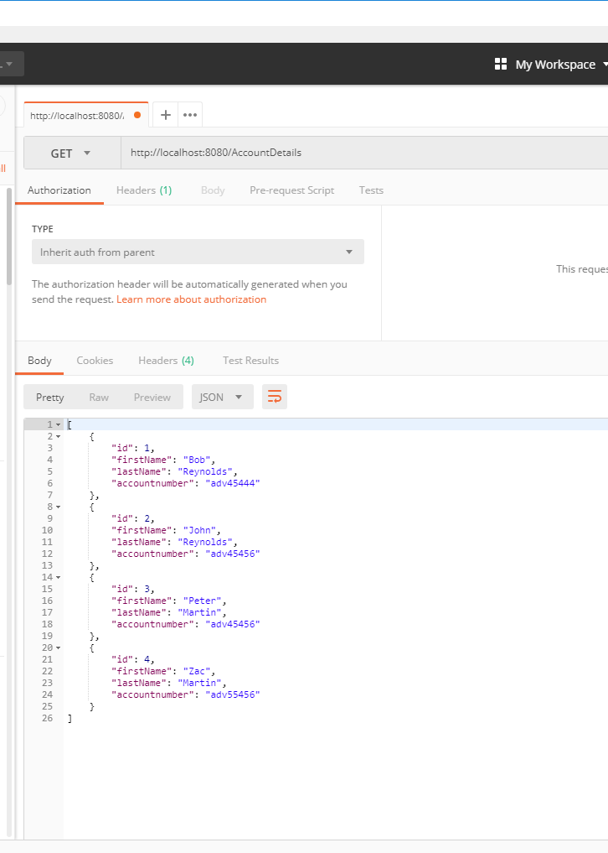
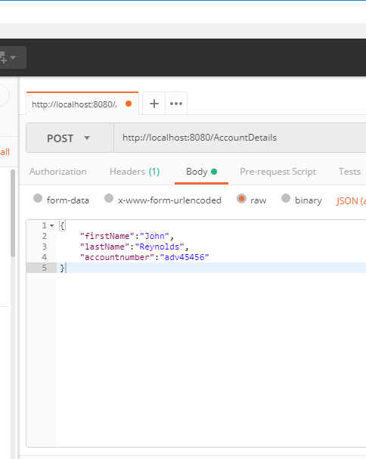
Backend
GET & POST on Postman.

Slide 5
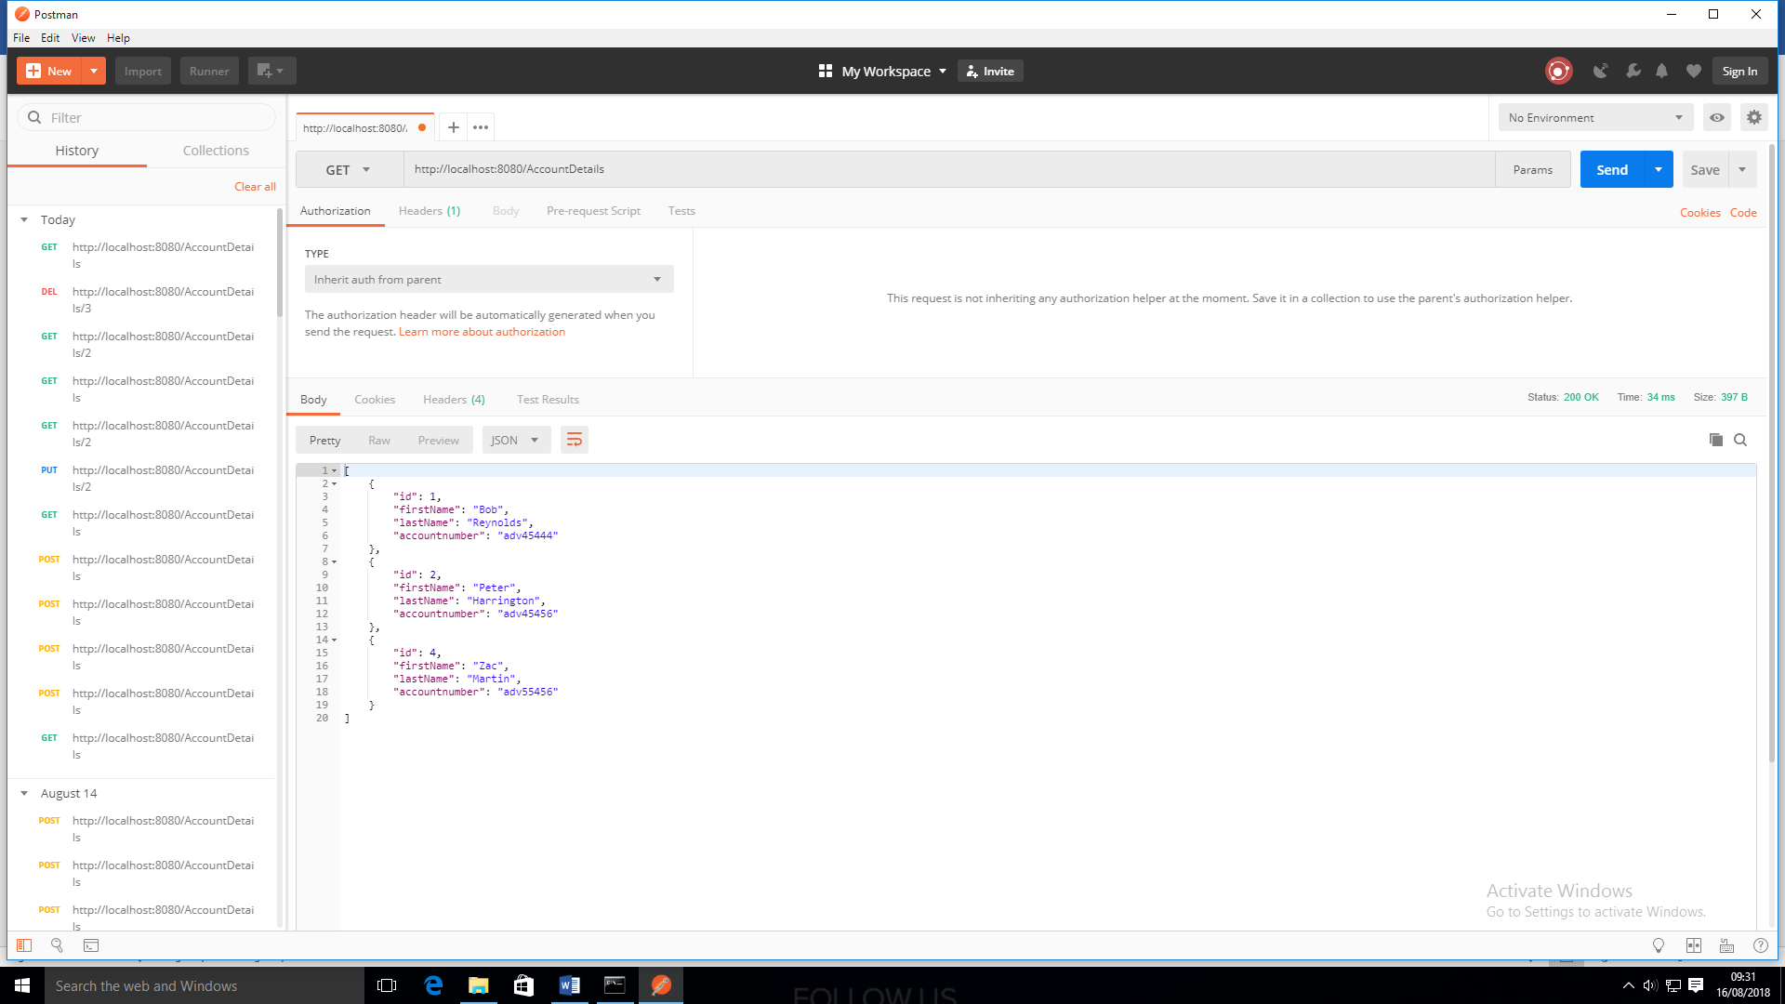
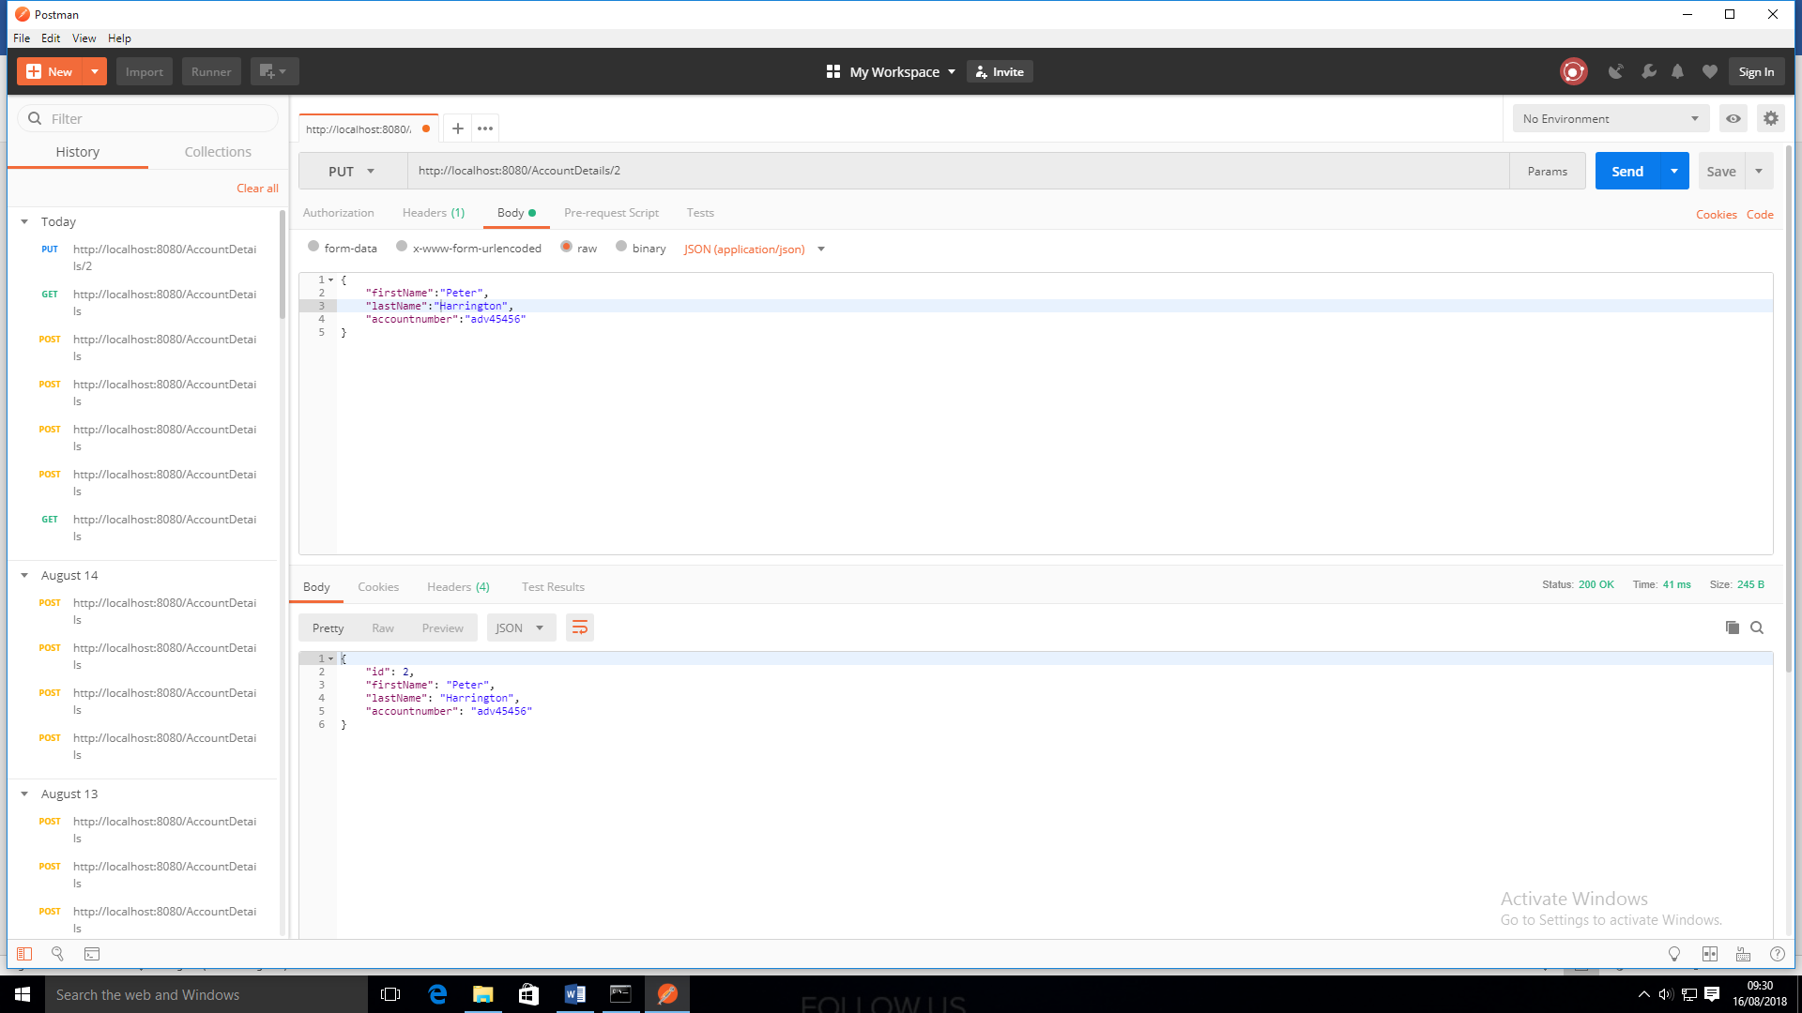
Backend
PUT Postman

Slide 6
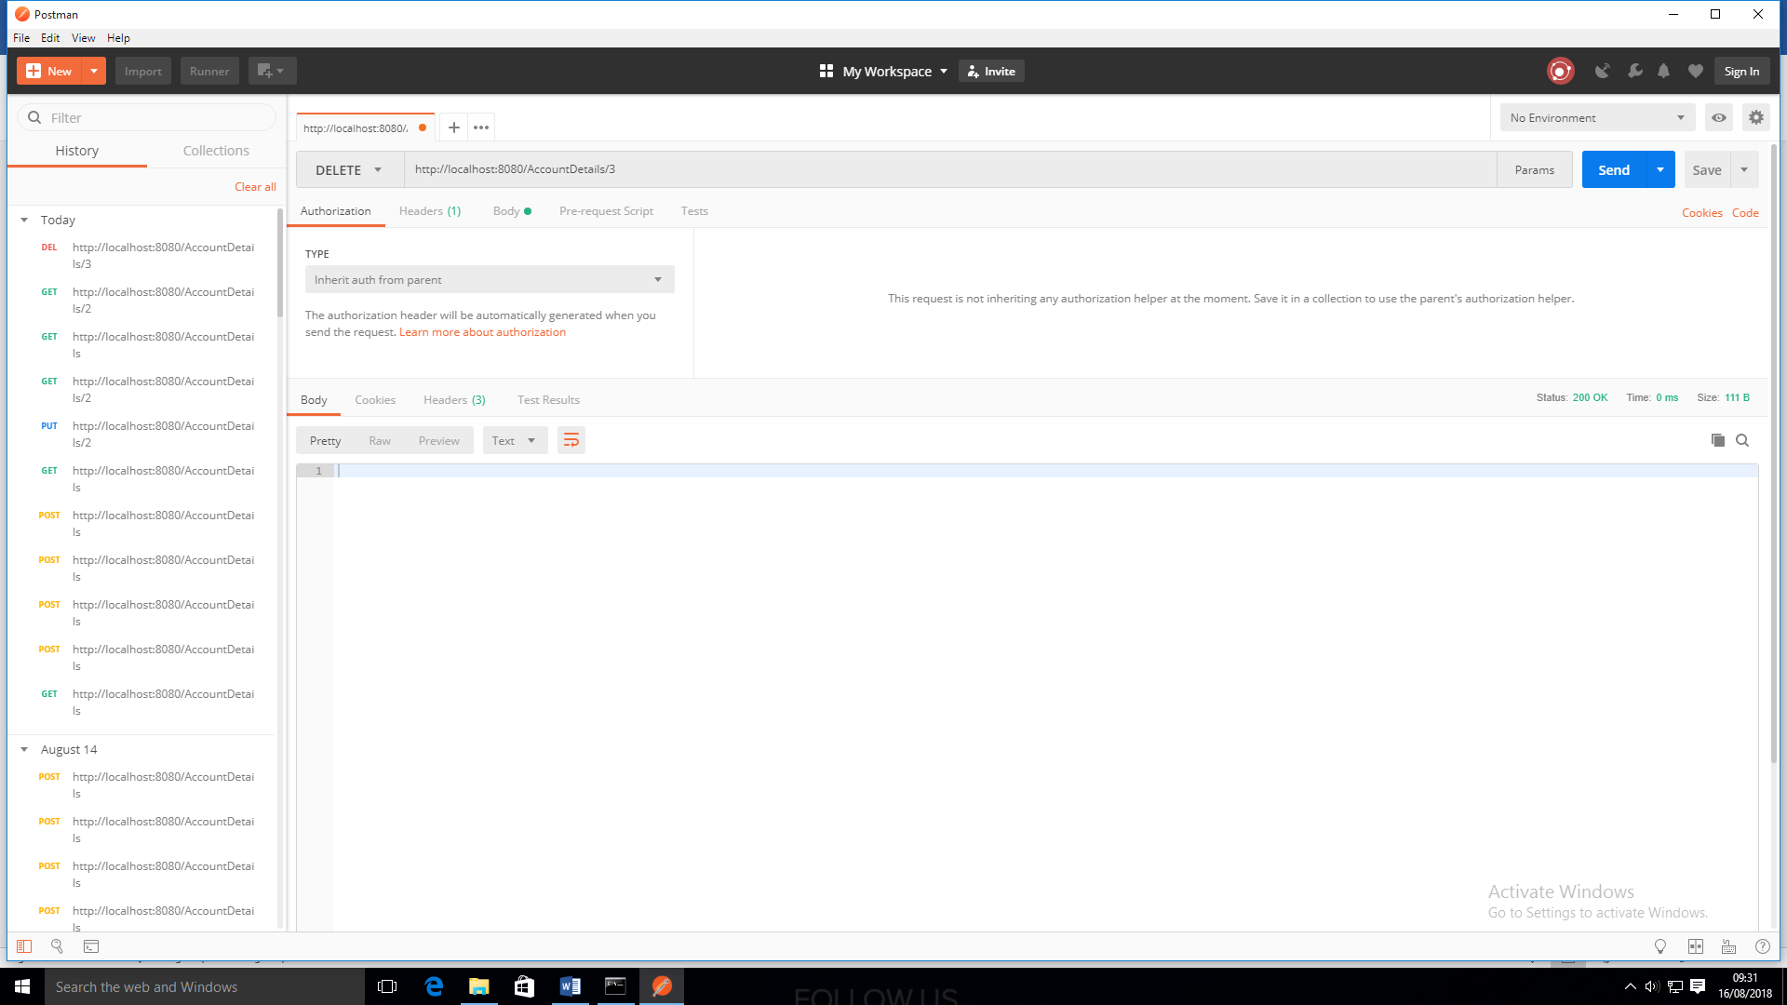
Backend
DELETE Postman.

Slide 7
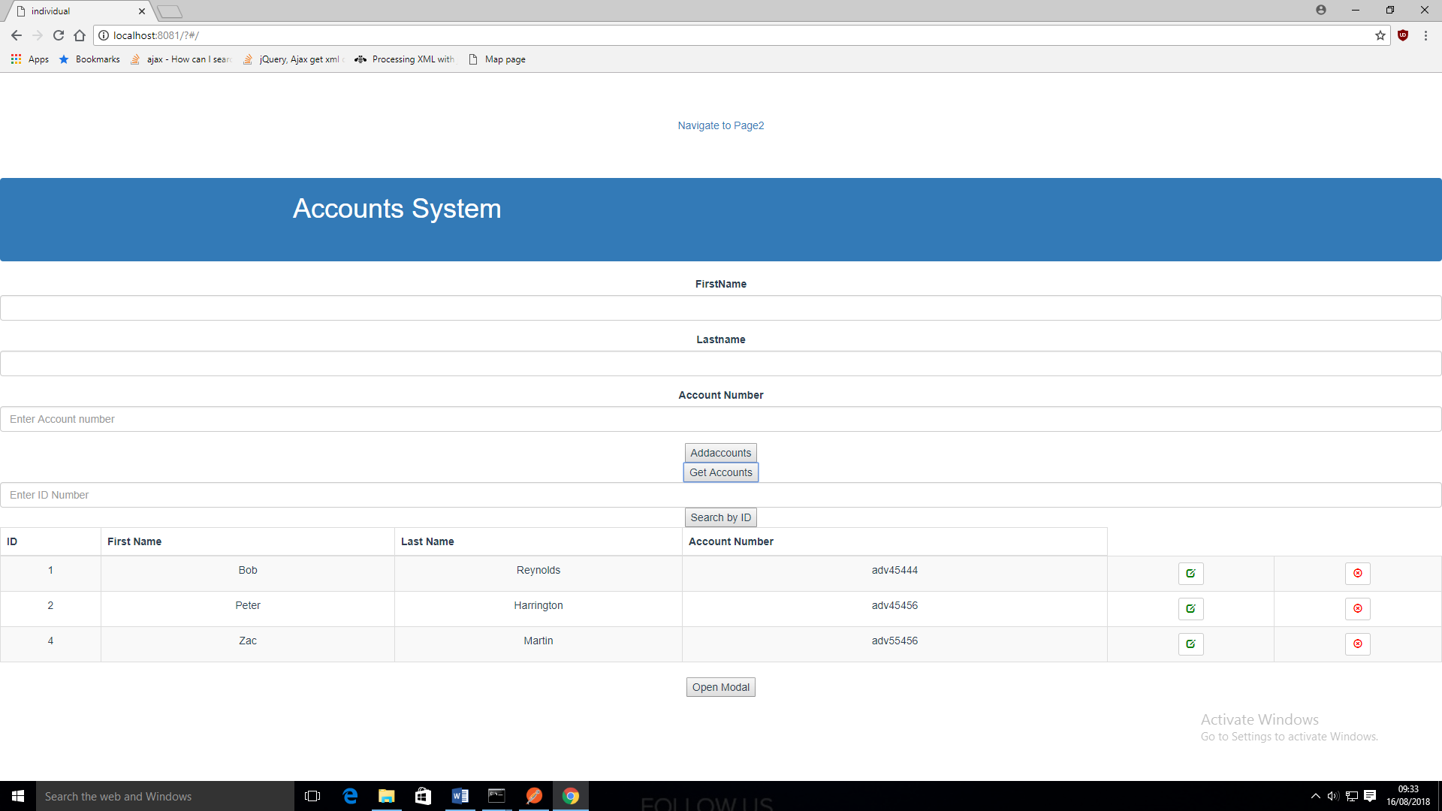
Frontend
GET ACCOUNTS

Slide 8
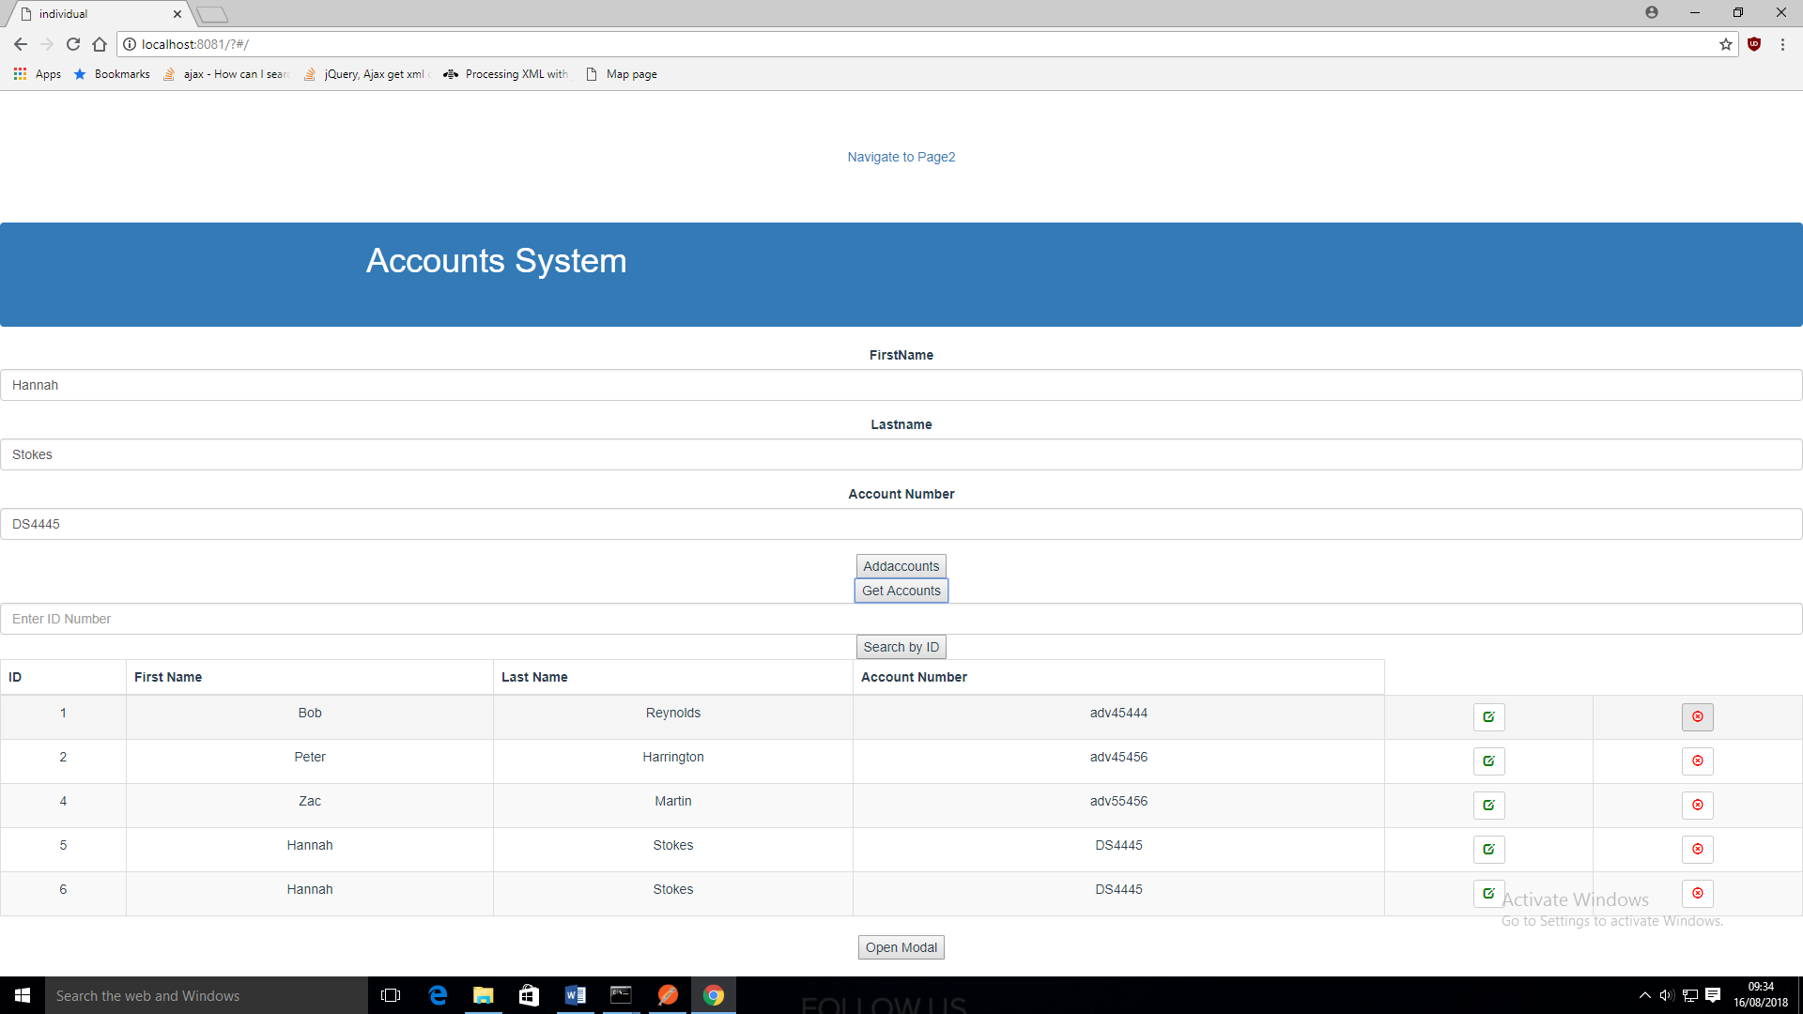
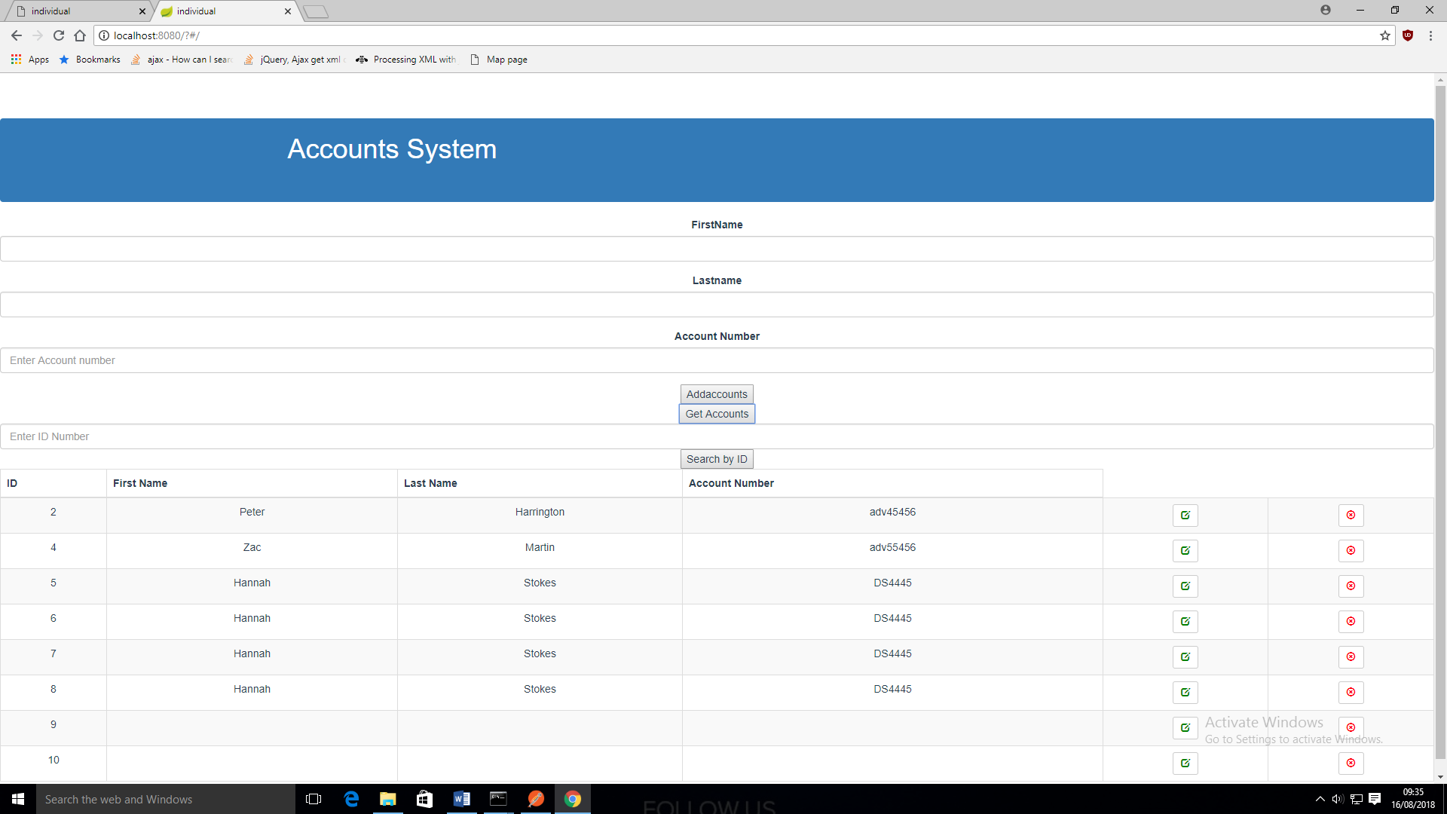
Frontend
DELETE ACCOUNTS
Deletes profile.

Slide 9
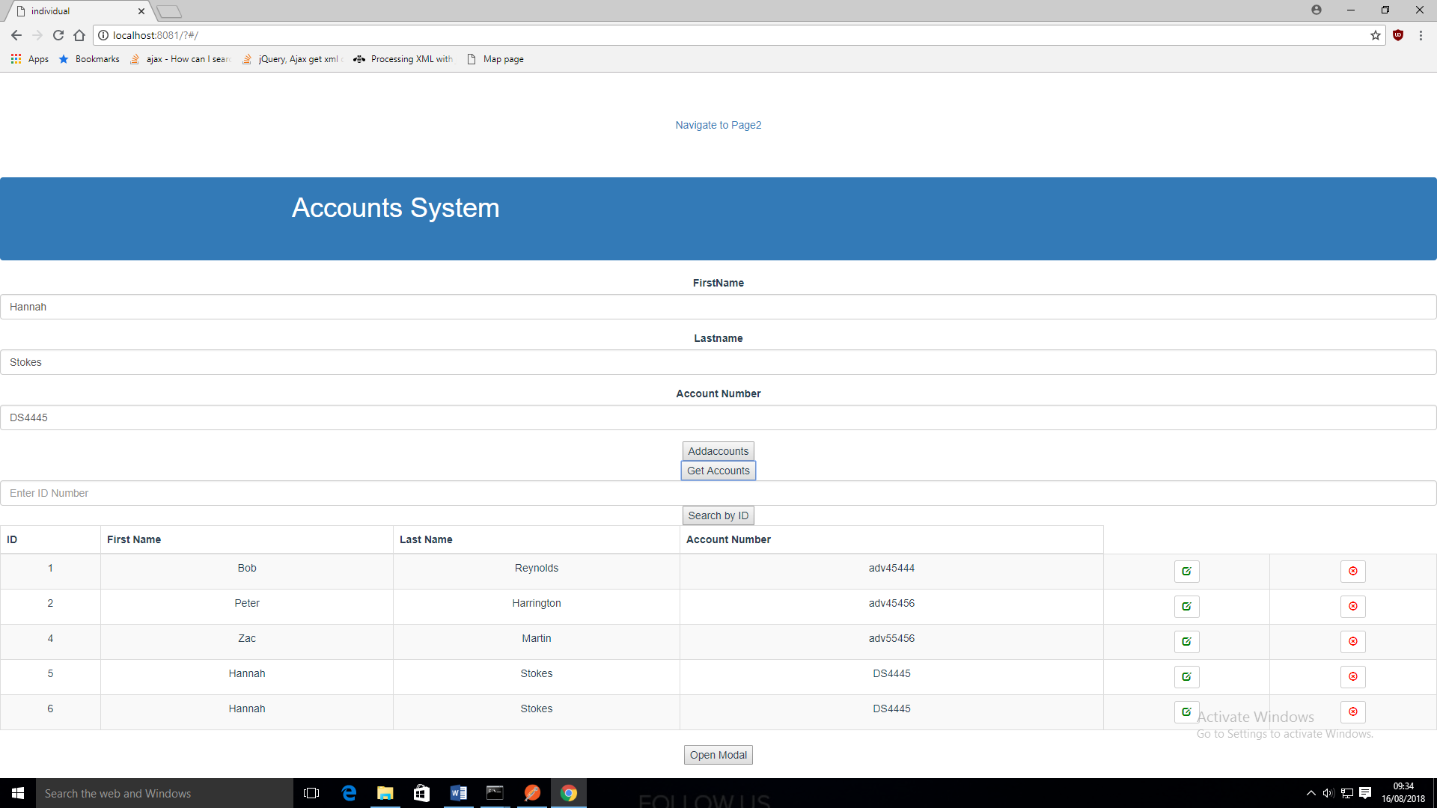
Frontend
ADD ACCOUNTS

Slide 10
Conclusion
Cross Browser Access
Tidying up Frontend page & code.
Needed more practise in Vue.js

Slide 11
Any Questions?

